Slide 1

“Exploratory Data Analysis of Buy Used Car Listings on Cars24”

Slide 2
Business Problem and Use Case Domain Understanding
Business Problem:
  The used car market has a wide range of prices, availability, and car conditions that vary across cities.
  The need is to analyze and aggregate this data for better decision-making, such as price comparison, and identifying trends in car market.
Use Case Domain:
  This analysis is focused on the Indian used car market. Understanding car prices, models, and other features can help businesses, such as car dealerships or customers, make informed decisions.
  Here I used data scraped from Cars24, a popular website in India for buying and selling used cars.

Slide 3
Objective of the Project
Main Objective:
  The goal is to extract and analyze used car listings data from various cities in India to gain insights into car prices, conditions, and trends.
  This can help dealerships optimize their pricing strategies and assist buyers in making well-informed decisions.
Specific Goals:
  Scrape used car data (e.g., brand, model, price, mileage, etc.) from multiple cities.
  Clean and preprocess the data for analysis.
  Perform exploratory data analysis (EDA) to identify patterns and correlations.

Slide 4
Web Scraping – Details
Website(s) Scraped:
  Data is scraped from Cars24 using URLs specific to different cities in India (e.g., Delhi, Mumbai, Hyderabad).
  URL :- https://www.cars24.com/buy-used-cars-delhi-ncr/?sort=bestmatch&serveWarrantyCount=true&storeCityId=1
Processor Followed:
  URL Generation: URLs are dynamically created for each city and filtered based on car owner type.
  HTML Parsing: Used BeautifulSoup to parse HTML and extract relevant details.
  Data Extraction: Extracted details like car model, brand, year, price, fuel type, mileage, etc.
  Data Clean-Up: Applied regular expressions and manual checks to ensure data accuracy.

Slide 5
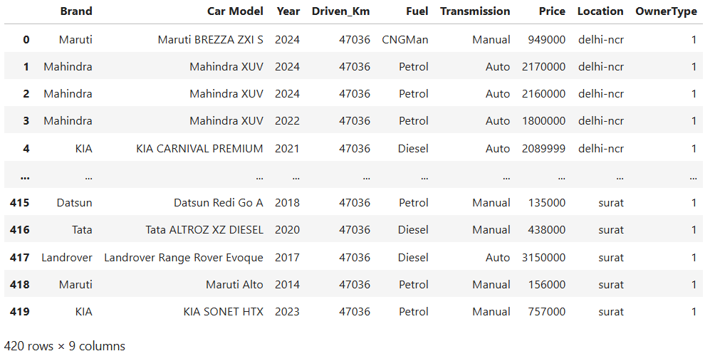
Summary of the Data
Sample Of Data:
Overview of Columns:
  Brand: Brand of the car (e.g., Toyota, Honda, etc.)
  Car Model: Specific model of the car.
  Year: Manufacturing year of the car.
  Driven_Km: Total kilometers driven by the car.
  Fuel: Fuel type (Petrol, Diesel, Electric, etc.)
  Transmission: Type of transmission (Manual, Automatic, etc.)
  Price: Price of the car (in INR).
  Location: City where the car is located.
  Owner Type: Whether the car is first-owner (binary flag).

Slide 6
Exploratory Data Analysis (EDA)
Data Cleaning Steps
Missing Values:
Identified and handled missing values in the dataset, particularly for driven kilometers.
Outliers:
Detected outliers in prices (e.g., very high-priced cars) and corrected where necessary.
Data Types:
Converted columns like price and mileage to appropriate numerical types for analysis.
Converted string-based numbers (with commas) to numeric types.
Statistical imputations:
  Mean for continuous variables like Driven_Km
Data Manipulation Steps
Feature Engineering:
  Converted the price units (Crore/lakh) to a unified scale (INR).
City Mapping:
  Mapped city names to their respective locations for easier analysis.

Slide 7
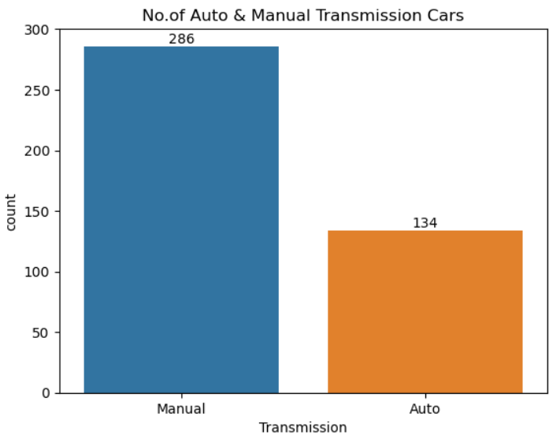
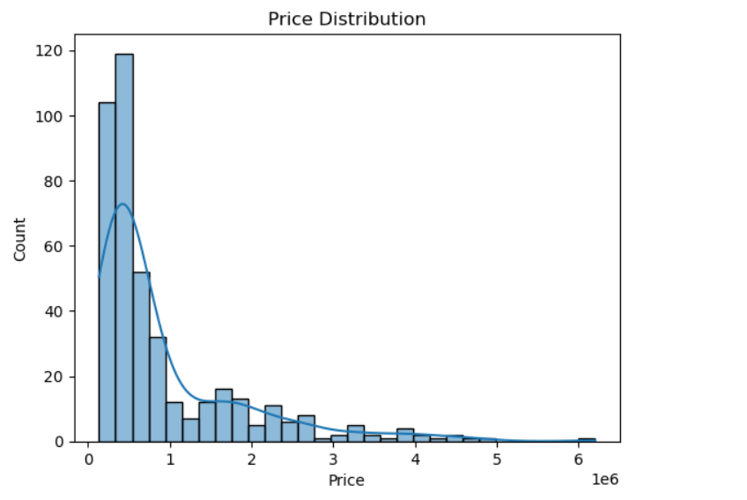
Univariate Analysis
Price Distribution:
  Display the distribution of car prices using histograms .
Transmission of cars
It shows majority of used cars are priced below 10 lakhs ,while a small portion falls with the ₹10-15lakh range and high priced vehicles are relatively rare in the dataset.
In the Bar chart shows the manual cars are more than the
Automatic cars.

Slide 8
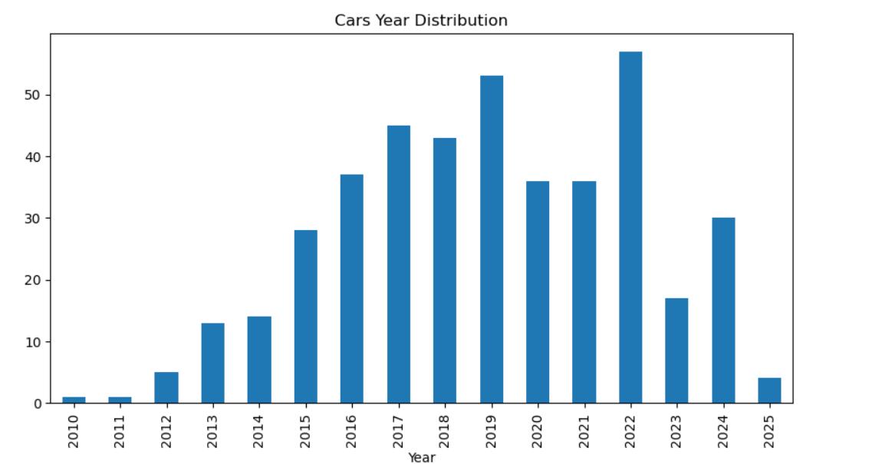
Year of Manufacture:
In the Bar chart indicated that most of used cars were manufactured between 2017 and 2022.
The highest concentration of listings is observed for years 2017,2019 and 2022 .
which implies new models dominated the used car market, reflecting customer demand for relatively recent vehicles.

Slide 9
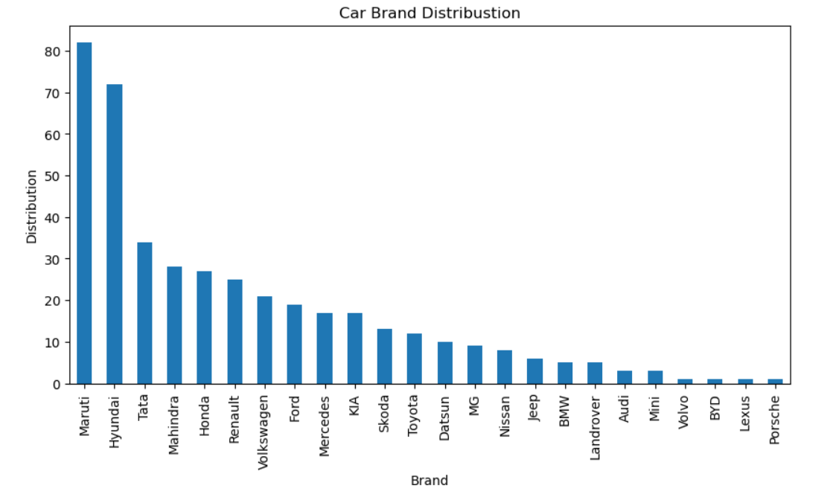
The Bar chart indicates the most popular car Brands among used car listing.
• Maruti, Hyundai and Tata are the top three Brands ,showing the highest no. of used cars available.
• others commonly listed brands include Honda, Renault, Mahendra, and Volkswagen.
• Premium Brands such as Volvo, BYD, Lexus and Porsche appear in small portion.

Slide 10
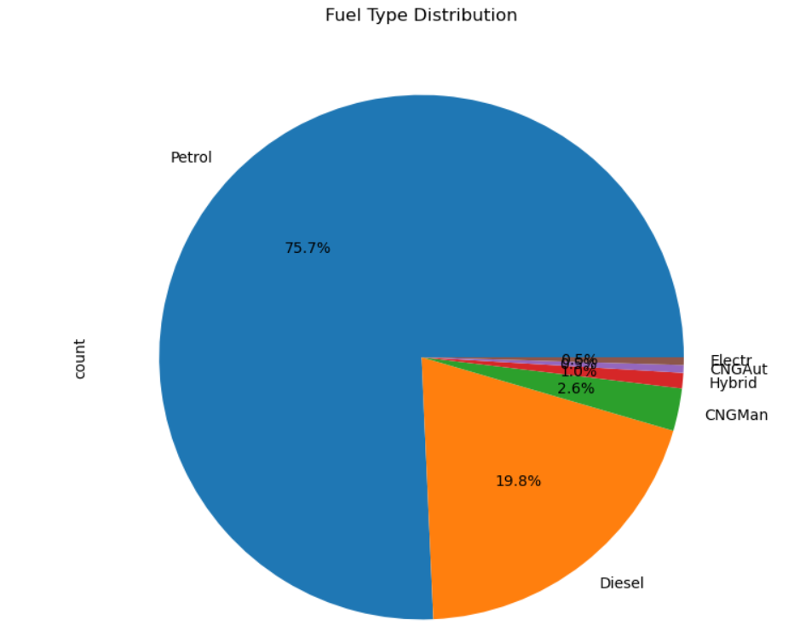
According to pie chat
Petrol cars are appoximately 75.7% of the total used cars available in the Cars24.
Diesel cars are 19.8% .
while CNGAut, Electr, Hybrid and CNGMan vehicles a small fraction.
This shows that petrol vehicles remain the most popular choice among the Indian users, due to easy of maintenance.

Slide 11
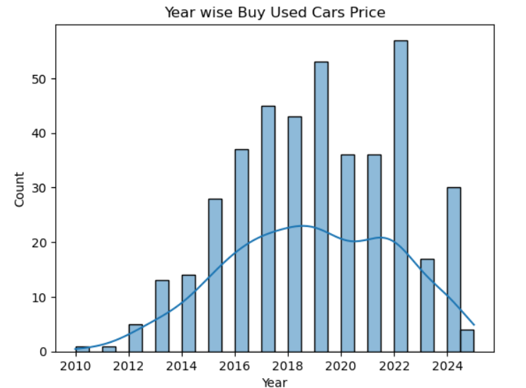
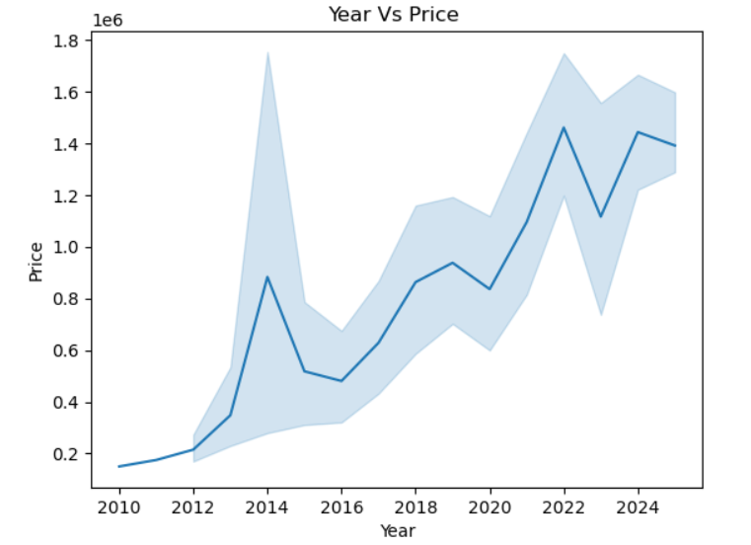
Bivariate Analysis :
Price Vs Year:
The line plot shows in average between 2010 and 2024. Newer model years especially after 2018 shows higher average prices ,reflecting greater demand for recent cars with updated features.
• Older cars before 2014 generally have lower resale values, as expected due to wear and outdated models.

Slide 12
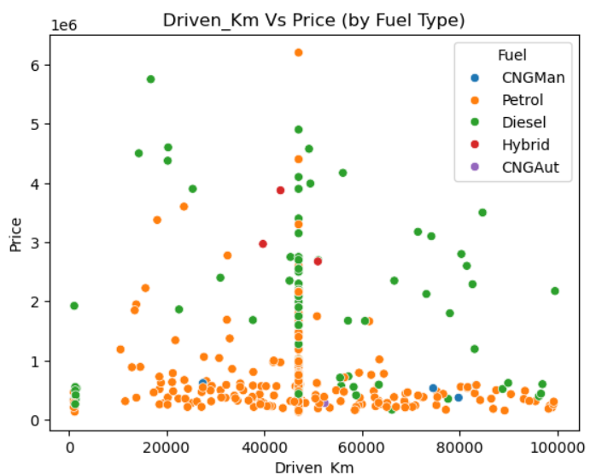
The scatter plot shows the relationship between the distance driven (in kilometers) and the price of used cars, categorized by fuel type such as petrol, Diesel, CNG, and Hybrid.
From the Visualization, Cars with lower milage generally have higher resale value, while longer distances lead to a drop in price due to usage and depreciation.
Diesel cars dominate at higher prices and milage.
Hybrid and CNG cars maintain better value at lower mileage due to good fuel efficiency and modern technology.
The analysis highlights low fuel type and distance driven affect resale value in the used car market.

Slide 13
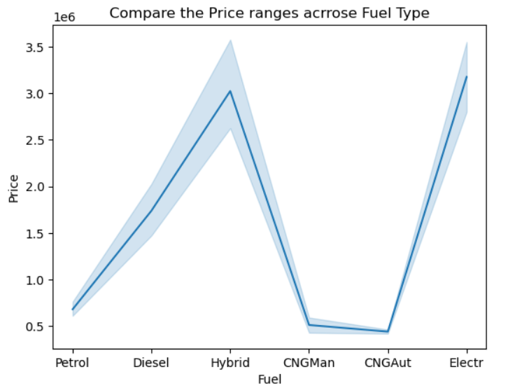
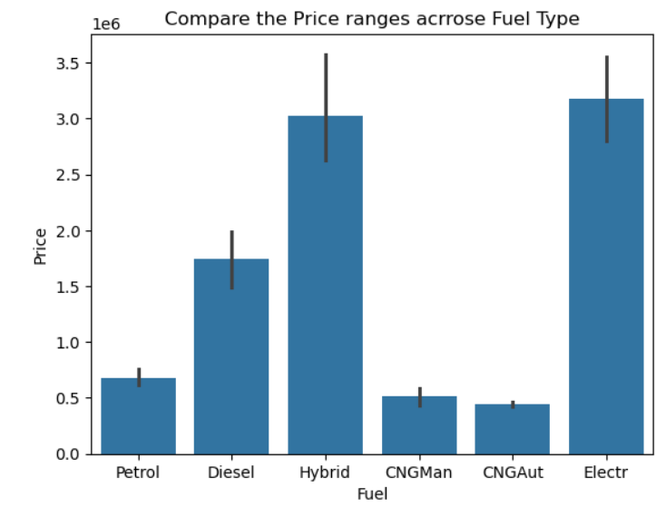
Price ranges across Fuel Type
The line plot comparing fuel types indicates the Electric ,Hybrid cars have highest price ranges ,likely due to newer Technology and better performance.
Diesel , petrol cars shows the moderate average Prices while CNGMan and CNGAut vehicles are on the lower end of the price scale. It indicates the Fuel Type significantly influences car pricing, with electric and diesel vehicles commanding premium prices.

Slide 14
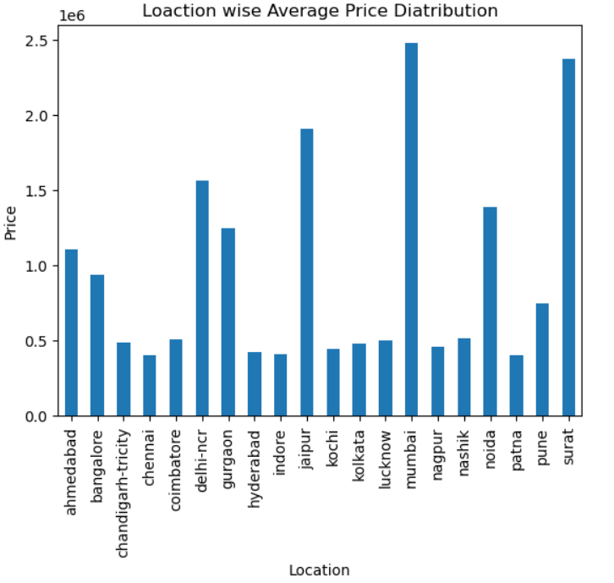
When compared to Location wise average prices of buy used cars ,cities like Mumbai,delhi-ncr,jaipur and Surat shows higher average prices than the other indian cities .
This means that the used car Market in the metro or economically strong cities tends to have higher prices, possibly due to:
Higher Demand and living standards,
Better vehicle maintenance and resale value,
More availability of premium models.

Slide 15
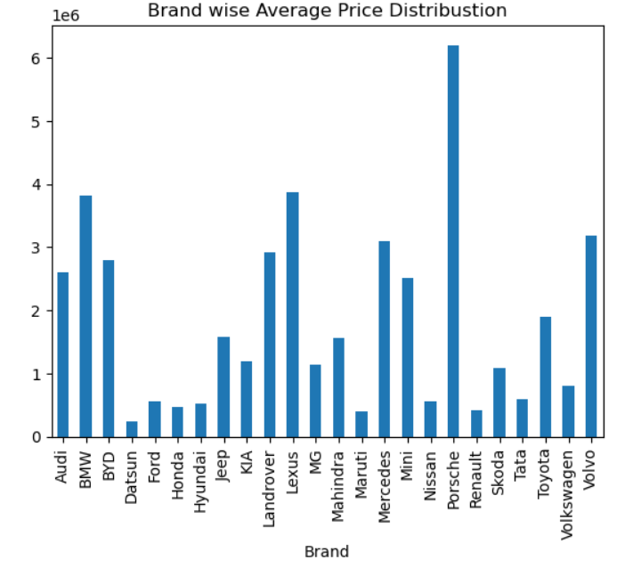
Brand wise buy used car price Analysis
Luxury car Brands such as Porsche , BMW, Mercedes, and Lexus display the highest average prices, reflecting their premium market value and advances features.
On the other hand , economy brands such as Maruti, Hyundai, Tata, Renault, and Datsun show comparatively lower prices, indicating affordability and widespread availability in the Indian market.
Brands like Toyota, Mahindra, and Jeep maintain mid-range prices, showcasing a balance between durability and performance.
Overall, the visualisation highlights how brand value plays a crucial role in determining the resale price of used cars- luxury brands retain higher value even in the second-hand market.

Slide 16
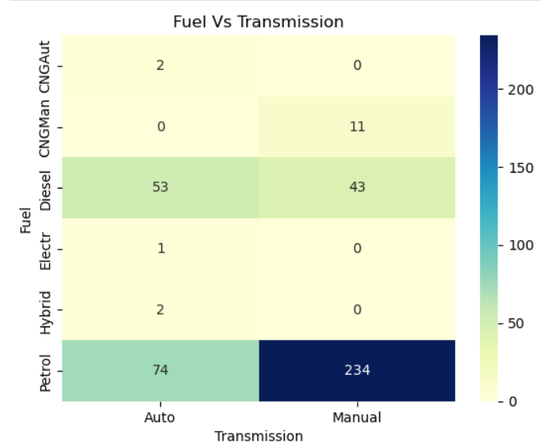
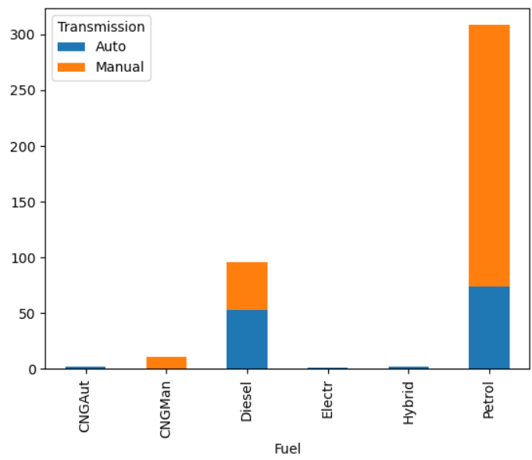
The Fuel Vs Transmission Heatmap and Bar chart shows that manual Transmission cars dominate across all Fual types, especially among the petrol vehicles , while Automic cars are more common premium and new models.

Slide 17
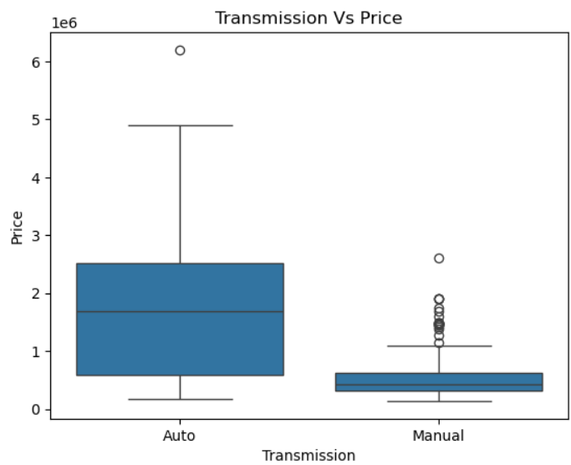
Transmission Vs. Price
I analyzed the relationship between transmission type and car price using a box plot. The results show that automatic transmission cars tend to be more expensive than manual ones.
The median price for automatic cars is significantly higher—around ₹20 lakhs—while manual cars have a lower median, closer to ₹5 lakhs.
The price range for automatic cars is also wider, with more variability and some high-end outliers, which likely represent luxury or newer models.
This suggests that automatic cars are often positioned in the premium segment, and buyers are willing to pay more for convenience and modern features.

Slide 18
Key Business Questions
What are the top most popular brands in the used car market?
I used a Bar chart to count listing by brand .Maruti, Hyundai, and Tata were the top three, followed by Honda and Renault. These brands dominate due to affordability and availability.
2.How does car age influence the resale price?
In Price Vs. Year plot and found that newer cars (2018-2022) have higher resale prices . Older models (Before 2014) show steep price drops , confirming expected depreciation trends.
Reflecting greater demand for recent cars with updated features.
3. Which fuel type offers the best resale value?
Electric and Hybrid cars had the highest average prices , likely due to newer technology . petrol cars were most common but moderately priced. Diesel and CNG had lower resale values overall.
4. What is the typical mileage (driven_km) for first-owner used cars?
I filter for first-owner cars and calculated average Driven kilometers. Most were under 50,000 km, indicating better condition and higher resale potential.
5. Which brands retain value best over time?
I compared average prices across year for each brand. Luxury brands like BMW , Porsche , Lexus retained higher prices even after several years. Mid-range brands like Toyota and Mahindra showed balanced depreciation.

Slide 19
Conclusion (Key Findings Overall)
Key Insights:
  The age of a car plays a significant role in determining its price, with newer cars being priced higher.
  There is a clear preference for certain car brands in the used car market, leading to higher prices for popular brands.
  Fuel type has a noticeable effect on pricing, with electric cars generally priced higher.
  Cities like Delhi and Mumbai show higher average prices due to demand.
  Driven kilometers have a strong negative correlation with car prices, with higher mileage reducing the price.
Next Steps:
  Create more regular analysis per city to compare pricing patterns.
  Explore potential factors affecting price such as condition, service history, etc.

Slide 20
Your Experience/Challenges working on Web Scraping – Data Analysis Project
While working on this project, I gained valuable hands-on experience in web scraping and data analysis using Python. The process of scraping data from the Cars24 website helped me understand how to extract real-world information, manage unstructured data, and transform it into a clean and organized dataset for further analysis. Though data visualization, I explored various graphical techniques such as bar charts, boxplots, histograms, line plots, and scatter plots to identify meaningful patterns and trends related to car prices, brands, fuel types, years, and transmission modes.
This project enhanced my technical skills in data preprocessing, visualization, and interpretation, while also improving my ability to draw insights from large datasets. Overall ,it was highly deepened my understanding of how data analytics can reveal market behaviour and consumer preferences in the used car industry.

